Slide 1
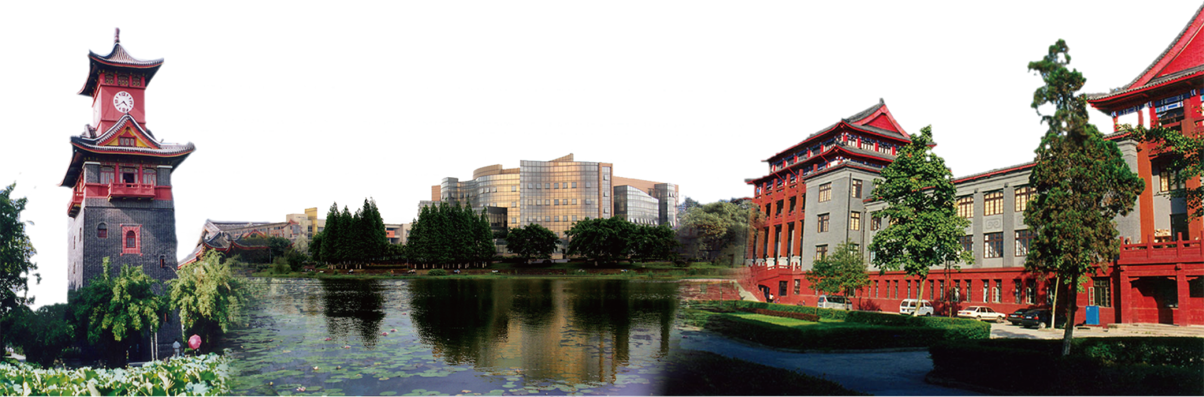
Foundations of Programming Design
Mengzhuo Guo
mengzhguo@scu.edu.cn
Business School, Sichuan University

Slide 2
Review - Why Learn Python
Programming is fun
  Turn ideas into reality
  Achieve goals step by step
  Thinking training
    A mindset for abstracting interactions and automating execution
    Computational thinking (design and construction): a third mode of thinking, distinct from logical thinking (reasoning and deduction - mathematics) and empirical thinking (experimentation and verification - physics)
  Not simply writing code:
    Solutions
    User experience and execution efficiency (for example, page-load latency in recommendation systems)

Slide 3
Review - Why Learn Python
Programming can improve efficiency
  Solve repetitive tasks in batches
  Increase a sense of accomplishment
Programming is one of today's basic skills
  Use computers to solve problems
  A workplace need in the information age
Is programming difficult to learn?
  No！
  Master basic syntax, concepts, and logic
  Think structurally about problems, decompose them step by step, and learn common patterns
  Study examples (GitHub) and learn to adapt them

Slide 4
Review - Installing Python
Anaconda python
  Virtual environment configuration:
    conda create --name
    conda env list
    conda env remove --name
    conda info
    conda activate
    conda deactivate
Notes:
可以播放视频

Slide 5
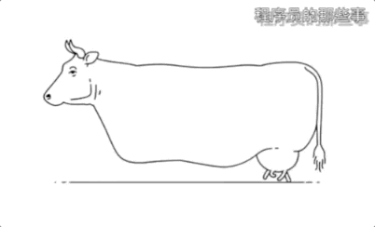
Review - Programming Approach
Recall：IPO
6 steps
  1. Analyze the problem: identify which parts require computation;
  2. Define boundaries: separate module responsibilities and plan the IPO;
  3. Design the algorithm: design the solution and focus on the algorithm itself;
  4. Write the program: coding;
  5. Debug and test: make sure the program runs correctly - not just runs, but runs right;
  6. Maintain later: upgrade, maintain, update, and improve.
Notes:
可以播放视频

Slide 6
S2. Python Language Fundamentals

Slide 7
A quick start for Jupyter
What is Jupyter Notebook?
It is a development tool
It divides a program into small pieces/blocks -- cells
Benefits?
It allows to run one cell at a time

Slide 8
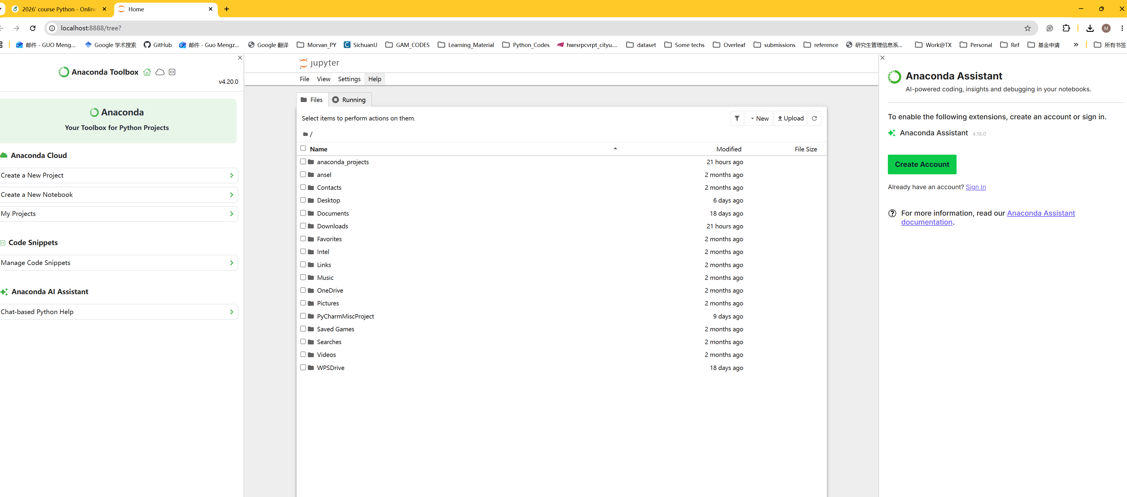
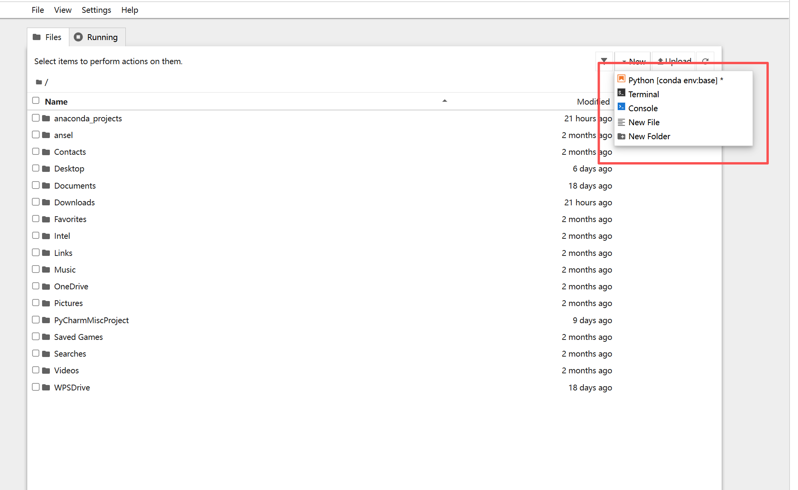
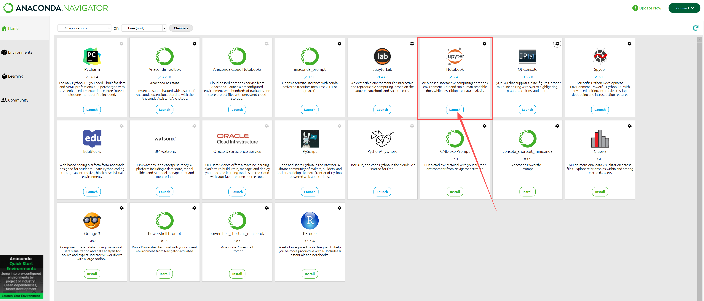
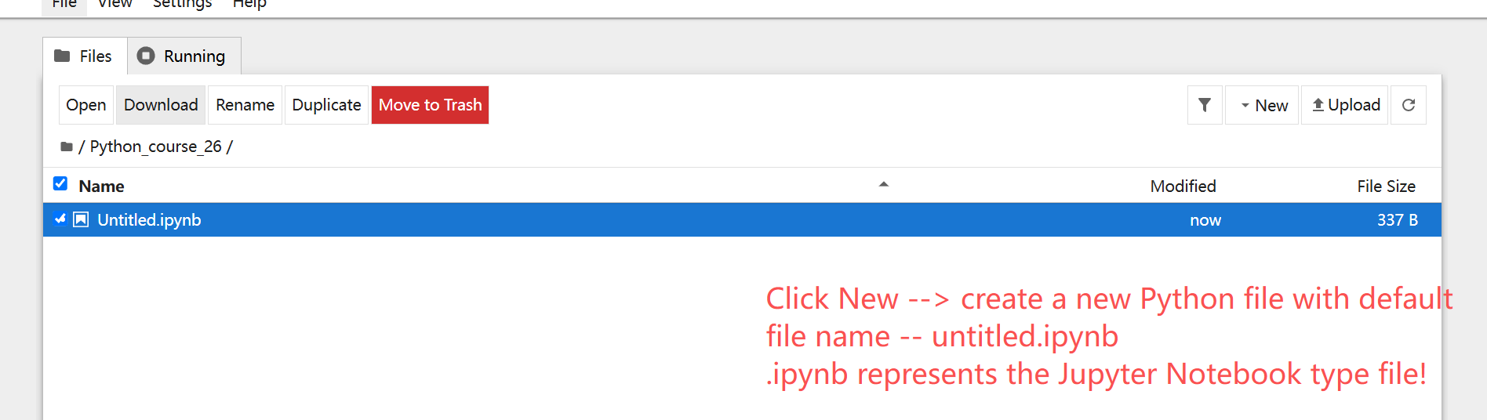
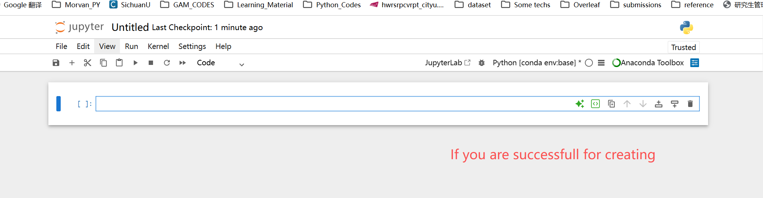
A quick start for Jupyter

Slide 9
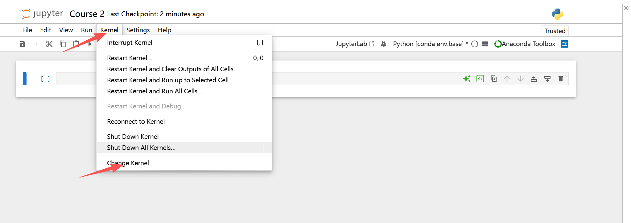
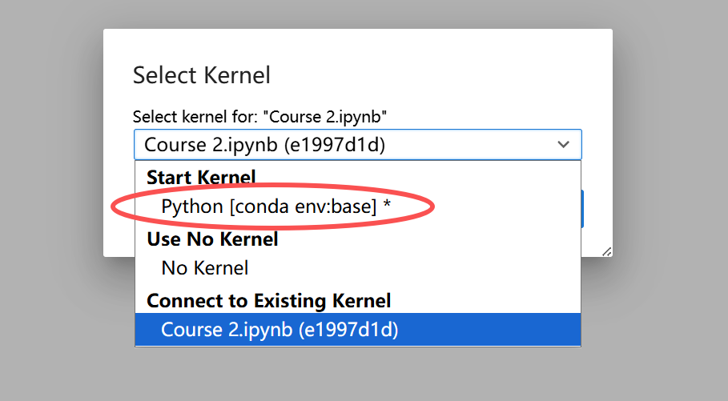
A quick start for Jupyter
We do not find our virtual env

Slide 10
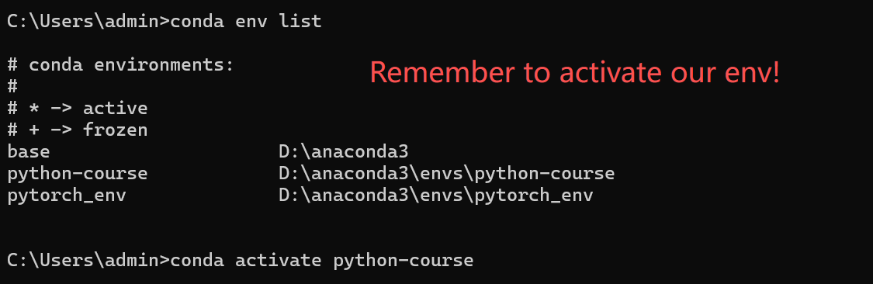
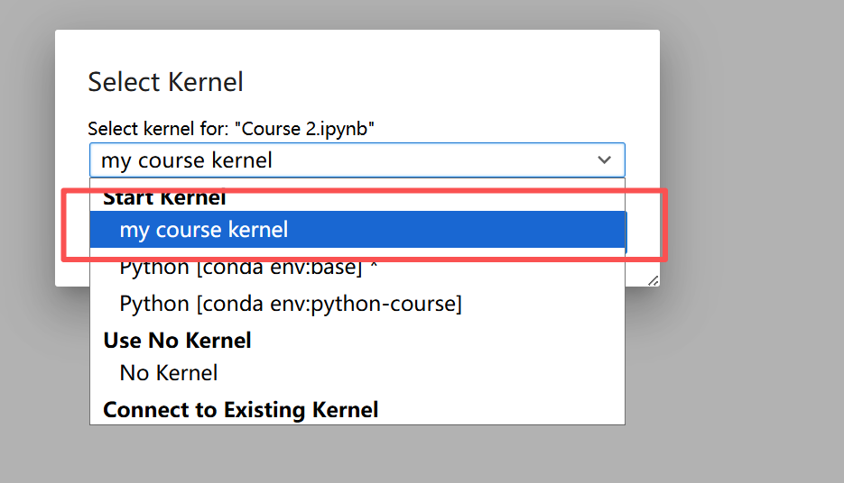
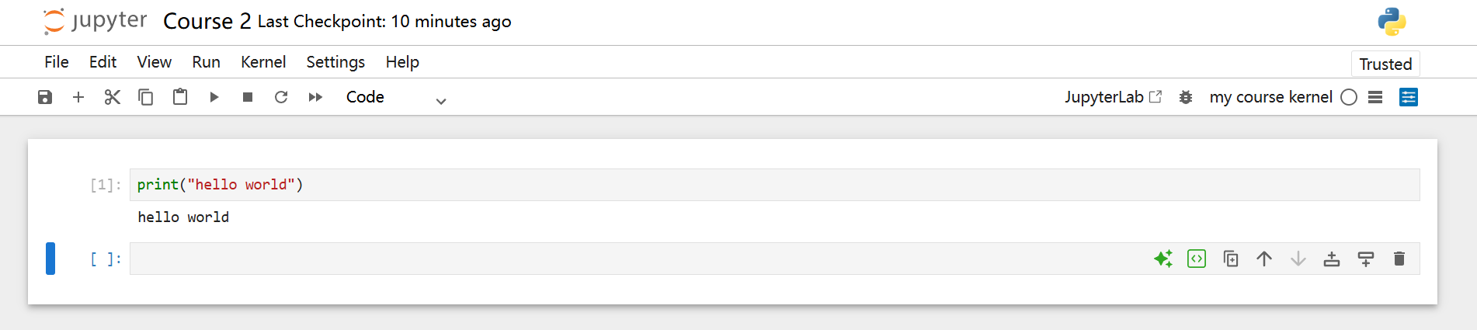
A quick start for Jupyter
How to register our virtual env as a kernel?
Enter the following 3 lines of codes:
1. conda install ipykernel
2. python -m ipykernel install --user --name=my_env --display-name="Python (my_env)"
(my_env should be your virtual env’s name!)

Slide 11
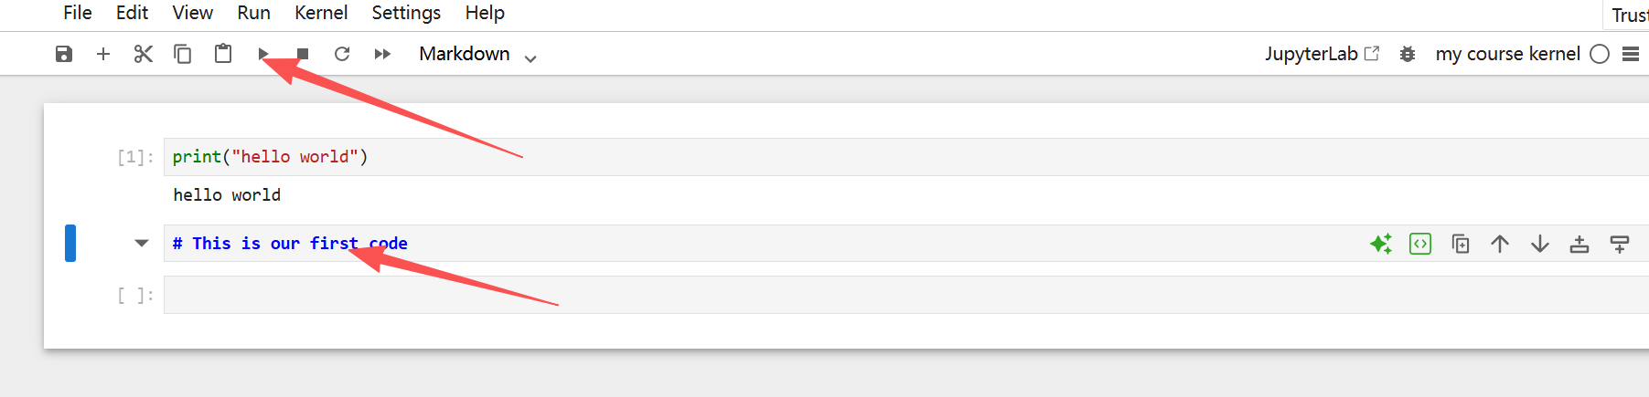
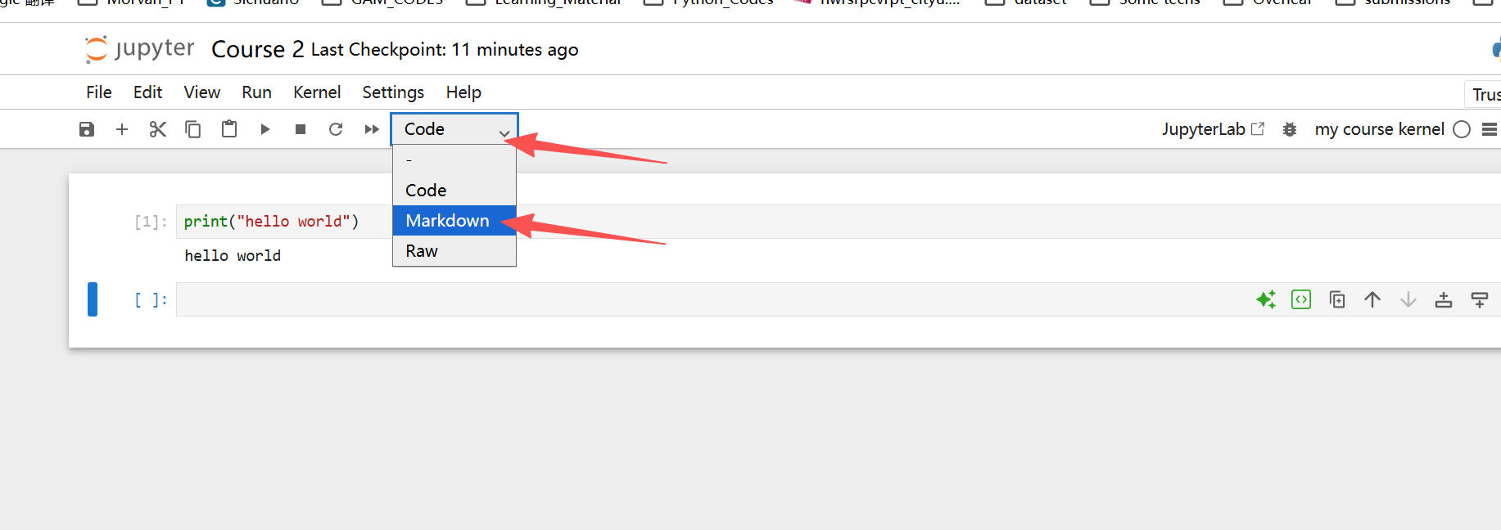
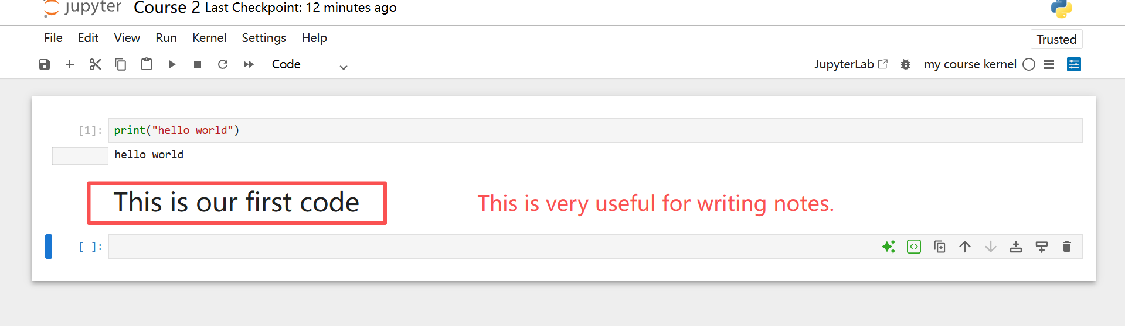
A quick start for Jupyter
If you know the Markdown for wrting notes

Slide 12
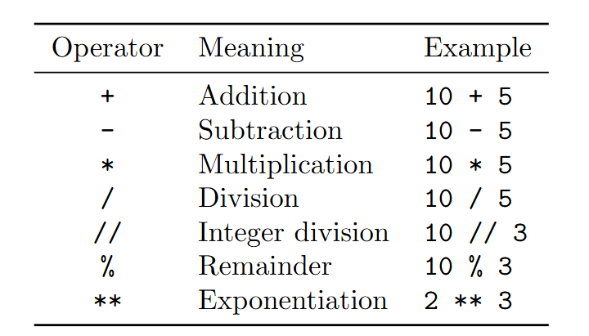
A quick start for Jupyter
Let us try some simple programs
The print() function displays information on the screen.
Try print some!
Your name
Your number
Some Basic Arithmetic
We can also define some variables (will be introduced later)
Example: (pls print these codes in your Jupyter)
price = 20
quantity = 3
total_cost = price * quantity
print(total_cost)
You can refer to the reading materials for more examples
Jupyter can receive user input
Example:
name = input("Please enter your name: ")
print("Hello,", name)

Slide 13
Example 2.1: Triangle Area Formula Calculation
Given the three sides of a triangle, calculate its area. Hint: assume the side lengths are a, b, and c;the triangle area is s = . Here, h is half of the triangle's perimeter.
What is the input? (What materials are needed to achieve the goal?)
  Side lengths? Perimeter?
What is the output?
  Perimeter? Area?
What is the operation?
  Calculation formula

Slide 14
Example 2.1: Triangle Area Formula Calculation
Given the three sides of a triangle, calculate its area. Hint: assume the side lengths are a, b, and c;the triangle area is s = . Here, h is half of the triangle's perimeter.
import math
a = 3.0
b = 4.0
c = 5.0
h = (a + b + c) / 2 # half of the triangle perimeter
s = math.sqrt(h*(h-a)*(h-b)*(h-c)) # triangle area
print(s)

Slide 15
Example 2.2: Temperature Conversion
Background: temperature scales
  Celsius: used in China and most other countries
    At 1 standard atmosphere, water freezes at 0 degrees and boils at 100 degrees; the scale is evenly divided.
  Fahrenheit: used in the United States, the United Kingdom, and other countries
    At 1 standard atmosphere, water freezes at 32 degrees and boils at 212 degrees; the scale is evenly divided.
Requirements analysis
  Convert Celsius to Fahrenheit
  Convert Fahrenheit to Celsius

Slide 16
Example 2.2: Temperature Conversion
Problem analysis:
  Direct conversion
    38°C --> 100.4°F
  Understand and convert temperature information released as audio or images
    Multimodal processing of images, audio, and more
    Weather forecast
  Monitor channels that publish temperature information, obtain values in real time, and convert them
    Web crawler
Difficulty increases!!

Slide 17
Example 2.2: Temperature Conversion
We only focus on "direct conversion"
Recall the problem-solving steps
    Plan the IPO - input, process, output
      Input: a temperature marked as Fahrenheit or Celsius
      Process: conversion algorithm
      Output: a temperature marked as Fahrenheit or Celsius
    Standardize the data format
      Put the temperature marker at the end: F means Fahrenheit, C means Celsius
        82F means 82 degrees Fahrenheit; 28C means 28 degrees Celsius

Slide 18
Example 2.2: Temperature Conversion
What approaches do we have?
  Direct mapping:
    Use a very large table that stores paired Celsius-Fahrenheit values
    Look it up each time, for example 38C -> 100.4F
      Advantage: simple and direct (lookup)
      Disadvantage: storage is cumbersome and not continuous
Not elegant, but simple
Notes:
让学生考虑一下

Slide 19
Example 2.2: Temperature Conversion
What approaches do we have?
  Programming approach:
    Find the conversion rule between the two temperature scales
      C = （F-32）/ 1.8
      F = C*1.8 + 32
    Determine whether the input is Fahrenheit or Celsius
    Convert according to the rule
Notes:
让学生考虑一下

Slide 20
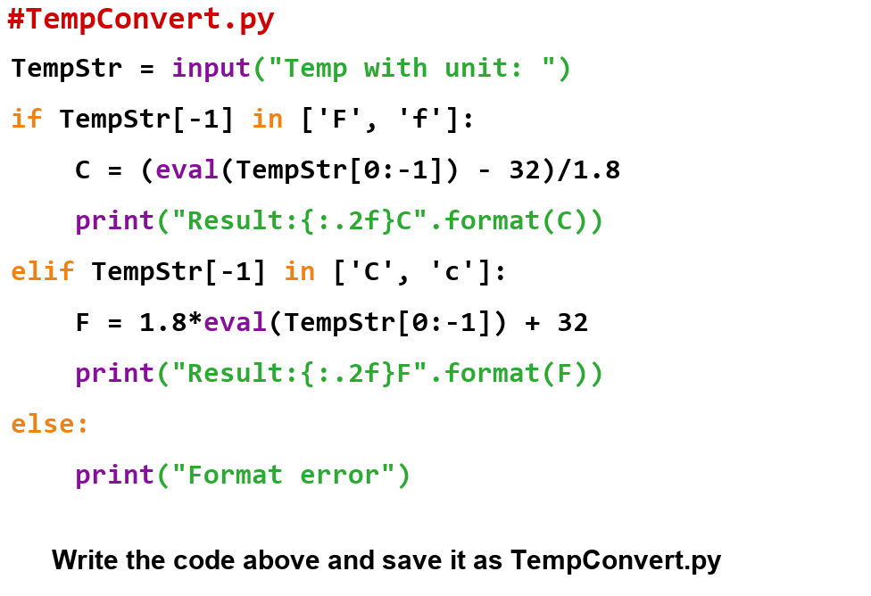
Example 2.2: Temperature Conversion
Apply the idea to similar cases
    Understand what each line of code means
      Look up unfamiliar functions in the documentation
    Try modifying part of the structure
      The relationship between F and C
      The input data format
        C82 F28
        82Ce 28F-
    Temperature conversion is a representative example of many conversion problems
      Currency conversion
      Length conversion
      Weight conversion
Notes:
让学生考虑一下

Slide 21
Key Points:
  2.1 Basic Python syntax
  2.2 Variables and constants
  2.3 Identifiers and naming rules
  2.4 Basic data types
  2.5 Comments
  2.6 Input and output
  2.7 Basic operators and expressions
  2.8 A case analysis (Temperature Transformation)

Slide 22

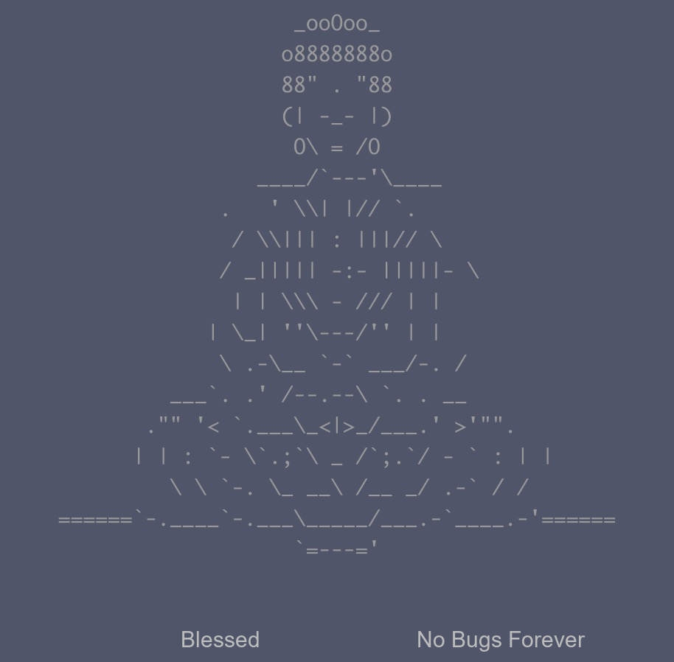
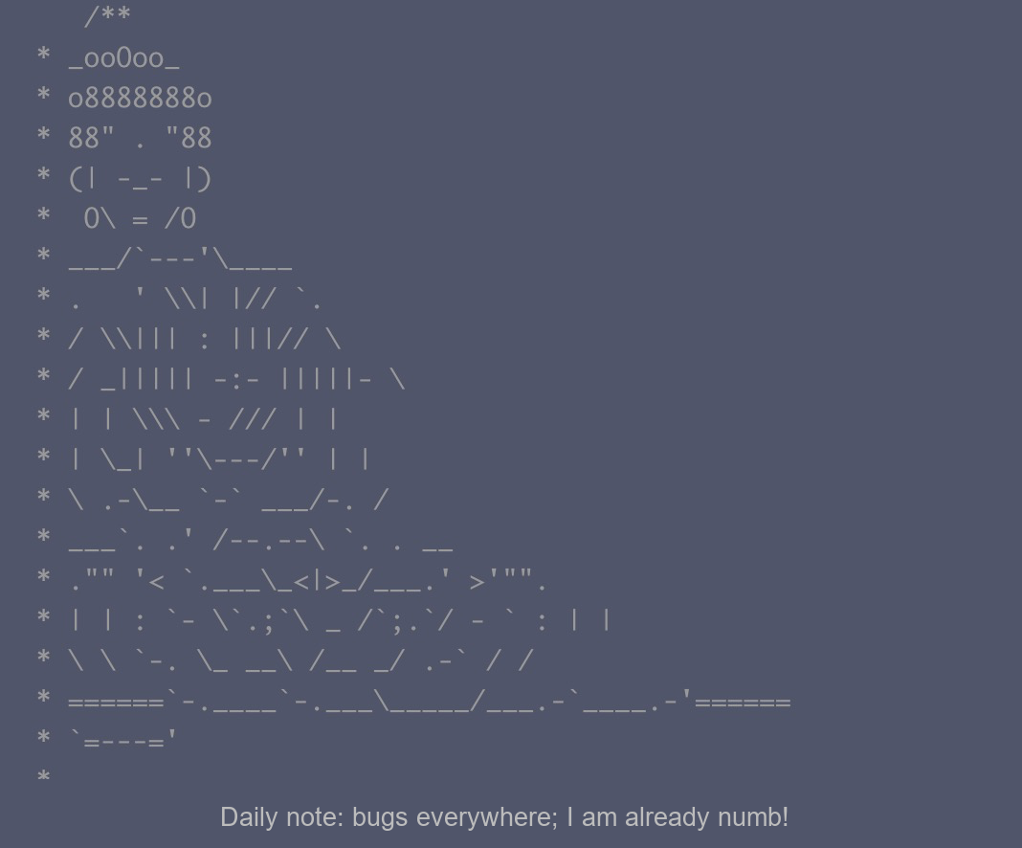
Basic Program Structure
One line of code is one command
Code color does not affect execution
  It depends on the interpreter or editor
Indentation: the blank space before a line of code; it shows the program structure
  Indentation errors cause program errors (IndentationError)
  Shows containment and hierarchy
    if, while, for
    Function definitions, etc.
Comments: improve readability
  Use # or '''xxx'''
  There are some interesting things about comments
Notes:
Ask students to think about it

Slide 23
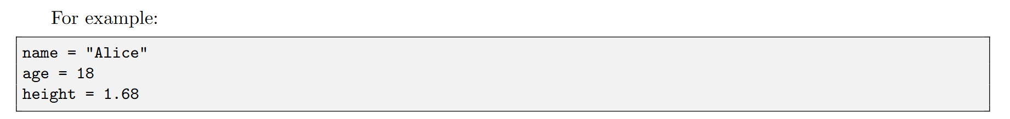
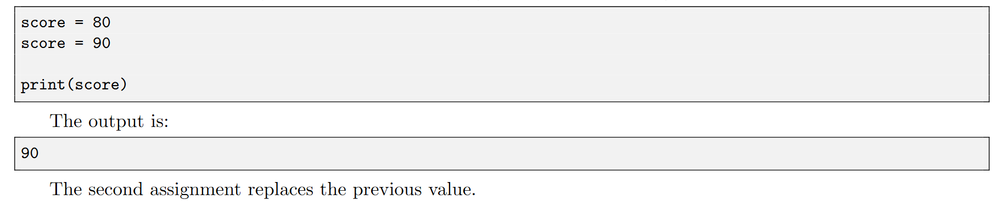
Variables and Constants in Programs
A variable is a name used to store a value.
  variable name = value
Notes:
Ask students to think about it

Slide 24
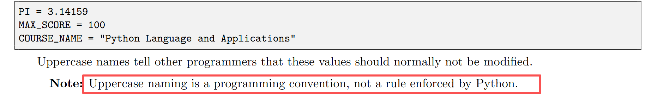
Variables and Constants in Programs
A constant is a value that is not expected to change during a program.
Notes:
让学生考虑一下

Slide 25
Variables and Constants in Programs
In the example
  TempStr, C, F
Variables
  Variables in Python do not need to be declared. They must be assigned before use.
  A variable is created only after it is assigned a value.
  Assign or change a variable: =
    C = “82F”
Notes:
让学生考虑一下

Slide 26
Variable Naming Rules
An identifier is a name used for a variable, function, class, or other object in a program.
  Identifier Naming Rules:
    May contain uppercase letters, lowercase letters, digits, and underscores
    TempStr, var1, var2
    Case-sensitive: Temp is not the same as temp
    The first character cannot be a digit
    Cannot be the same as a reserved word
    Cannot contain spaces

Slide 27
Naming and Reserved Words
Reserved words: identifiers defined and reserved by Python internally
  Python has 33 reserved words
    if, else, elif, in
  Basic words; case-sensitive
    if and IF?
Notes:
Ask students to think about it

Slide 28
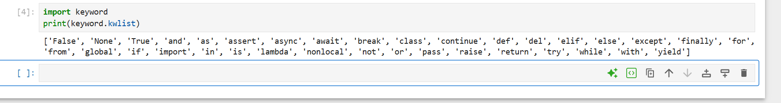
Naming and Reserved Words (Keywords)
View Python reserved words
  import keyword
  print(keyword.kwlist)
Python 3.8:
  ['False', 'None', 'True', 'and', 'as', 'assert', 'async', 'await', 'break', 'class', 'continue', 'def', 'del', 'elif', 'else', 'except', 'finally', 'for', 'from', 'global', 'if', 'import', 'in', 'is', 'lambda', 'nonlocal', 'not', 'or', 'pass', 'raise', 'return', 'try', 'while', 'with', 'yield']
Notes:
Ask students to think about it

Slide 29
Naming and Reserved Words
Value Keywords
  These keywords represent specific values:
Operator Keywords
  Logic and Boolean operations:
Keyword | Description | Example
True | Boolean true value | flag = True
False | Boolean false value | flag = False
None | Represents null or no value | result = None
Keyword | Description | Example
and | Logical AND | if x > 0 and x < 10:
or | Logical OR | if x < 0 or x > 100:
not | Logical NOT | if not is_valid:
is | Object identity comparison | if x is None:
in | Membership test | if 'a' in 'apple':
Notes:
Ask students to think about it

Slide 30
Naming and Reserved Words
Control Flow Keywords
  Control the program execution flow:
Keyword | Description | Example
if | Conditional statement | if x > 0: print("Positive")
elif | Else if | elif x == 0: print("Zero")
else | Else | else: print("Negative")
for | Loop statement | for i in range(5):
while | Loop statement | while x > 0:
break | Break out of a loop | break
continue | Continue to the next iteration | continue
Notes:
Ask students to think about it

Slide 31
Naming and Reserved Words
Function- and Class-Related Keywords
  Used to define and operate on functions and classes:
Keyword | Description | Example
def | Define a function | def my_func():
return | Function return value | return x + y
lambda | Anonymous function | f = lambda x: x**2
class | Define a class | class MyClass:
pass | Empty statement placeholder | pass
Notes:
Ask students to think about it

Slide 32
Naming and Reserved Words
Exception Handling Keywords
  Handle exceptions in a program:
Keyword | Description | Example
try | Try to execute a code block | try:
except | Catch an exception | except ValueError:
finally | Execute whether or not an exception occurs | finally:
raise | Raise an exception | raise ValueError("Invalid")
Notes:
Ask students to think about it

Slide 33
Naming and Reserved Words
Import and Module Keywords
  Manage modules and imports:
Keyword | Description | Example
import | Import a module | import math
from | Import specific content from a module | from math import sqrt
as | Alias | import numpy as np
Notes:
Ask students to think about it

Slide 34
Naming and Reserved Words
Variable Scope Keywords
  Control variable scope:
Keyword | Description | Example
global | Declare a global variable | global count
nonlocal | Declare a nonlocal variable | nonlocal x
Notes:
Ask students to think about it

Slide 35
Naming and Reserved Words
Other
Keyword | Description | Example
async | Define an async function | async def fetch():
await | Wait for an async operation to complete | await response
Keyword | Description | Example
del | Delete a reference | del my_list[0]
with | Context management | with open('file') as f:
yield | Generator return value | yield x
assert | Assert that a condition is true | assert x > 0
Notes:
Ask students to think about it

Slide 36
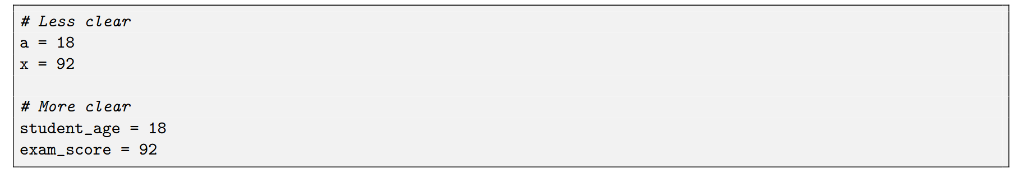
Recommended Naming Rules
Variable names should be clear and meaningful. Use underscores
  Make variable names meaningful whenever possible
  Lowercase -- variable
  Uppercase -- constant
Avoid unclear names when possible.
Notes:
Ask students to think about it

Slide 37
Naming and Reserved Words
Some naming rules
  Make it as easy as possible for readers to understand the meaning of functions, classes, and variables
Type | Naming Rule | Example
Module/package names | All lowercase, simple, and meaningful; use underscores if needed (we basically do not cover this) | math、sys
Function names | All lowercase; use underscores to improve readability | my_func()
Variable names | All lowercase; use underscores to improve readability | age、my_var
Class names | Use PascalCase: for names made of multiple words, capitalize the first letter of each word and keep the rest lowercase | MyClass
Constant names | All uppercase; use underscores to improve readability | TAX_RATE
Notes:
Ask students to think about it

Slide 38
Naming and Reserved Words
Are the following correct?
  2nd_place = "silver"
  user-name = "Bob"
  class = "Math"
  $price = 9.99
  for = "loop"
Notes:
Incorrect example

Slide 39
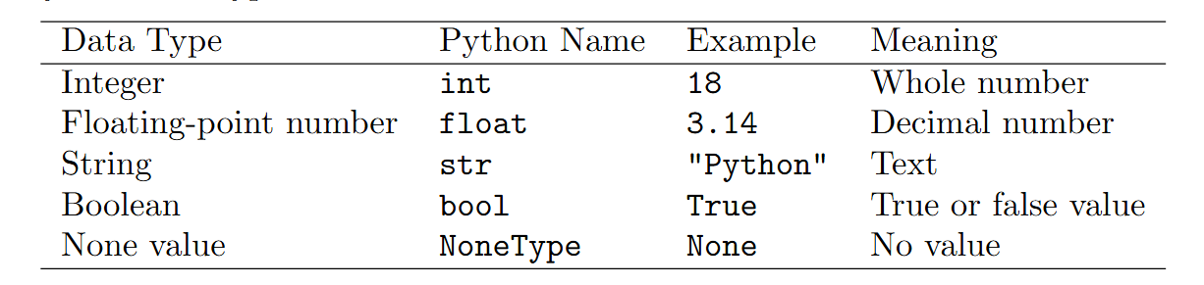
Data Types -- A data type describes the kind of value stored in a variable
In Python, a variable itself has no type. The "type" refers to the type of the object in memory that the variable points to.
Common data types in Python 3 include:
  Number
  String
  bool
  List
  Tuple
  Set
  Dictionary
The built-in type() function can be used to query the type of the object a variable points to.
Notes:
Ask students to think about it

Slide 40
Data Types -- Why Are They Important?
Without data types, how should 10,011,101 be interpreted?
  A number?
    Binary: 157
    Decimal: 10,011,101
  Text?
    It is a string, and each character is a digit
  Three comma-separated numbers?
  Data type determines which operations make sense~
  Example:
    Integer type: directly enter 10011101
    String type: '10,011,101'
    List type: [10, 011, 101]
Notes:
Ask students to think about it

Slide 41
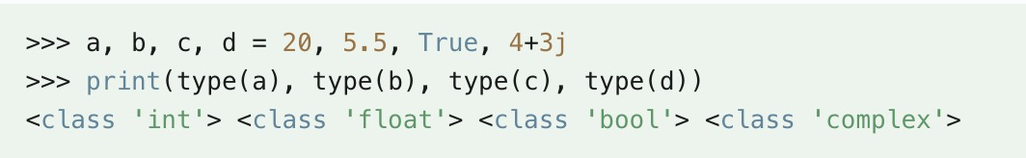
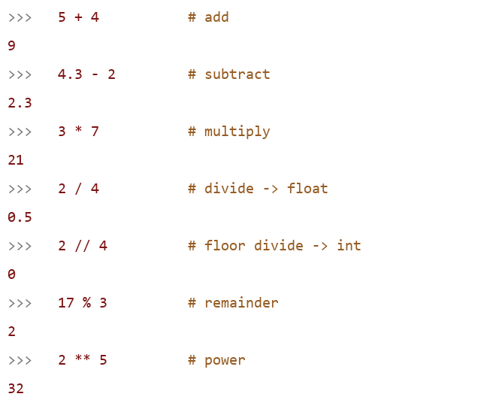
Data Types - Number
Python 3 supports int, float, bool, and complex
  There is only one integer type, int, represented as a long integer;
    Example:
  Direct calculations:
Notes:
Ask students to think about it

Slide 42
Data Types - String: A string is a sequence of characters used to represent text
Strings in Python are enclosed in single quotes ' or double quotes ", and backslashes \ are used to escape special characters
  Because String is a sequence, each character has a position -- index;
  String indexing!
    variable[start_index:end_index]
    Indexing starts at 0; -1 refers to the last position
Notes:
Ask students to think about it

Slide 43
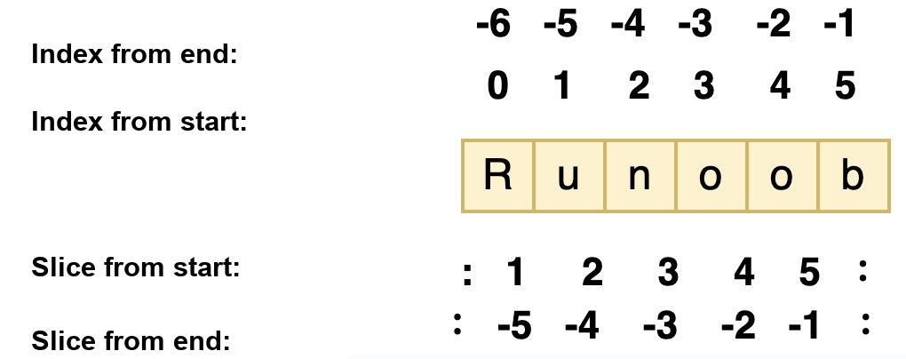
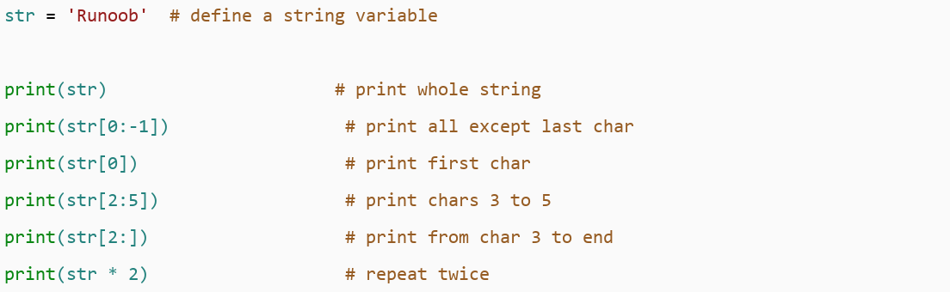
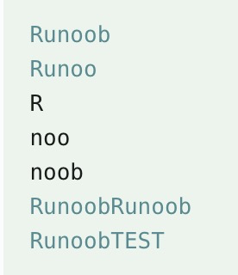
Data Types - String
  Example: str = "runoob" or 'runoob'
    +: string concatenation operator
    *: repeats the string.
Notes:
Ask students to think about it

Slide 44
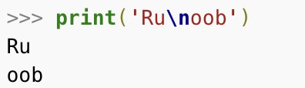

Data Types - String
  Example: str = "runoob" or 'runoob'
    Backslash \ escapes special characters: \n is a newline, e.g., print('Ru\noob')
    If you do not want backslashes to escape characters, add r before the string to create a raw string, e.g., print(r'Ru\noob')
    Strings are immutable
      str[0] = 'm' --> Error
Notes:
Ask students to think about it

Slide 45
Data Types - Bool
  The Boolean type is True or False
    Recall: True and False are both keywords
    Booleans can control program flow, such as checking whether a condition is true or running a block of code when a condition is met
    bool is a subclass of int. Boolean values can be treated as integers: True is equivalent to 1, so it can be compared with other data types
    Booleans can be used with logical operators, including and, or, and not. These operators combine Boolean expressions to produce a new Boolean value.
    In Python, all nonzero numbers and nonempty strings, lists, tuples, and similar data types are treated as True; only 0, empty strings, empty lists, empty tuples, and similar values are treated as False.
Notes:
Ask students to think about it

Slide 46
Data Types - Bool
  Example:
    Integer representation of Booleans:
      print(int(True))
        # 1
      print(int(False))
        # 0
Notes:
Ask students to think about it

Slide 47
Data Types - Bool
  Example:
    Use the bool() function for conversion
      print(bool(0))
        # False
      print(bool(42))
        # True
      print(bool(''))
        # False
      print(bool('Python'))
        # True
      print(bool([]))
        # False
      print(bool([1, 2, 3]))
        # True
Notes:
Ask students to think about it

Slide 48
Data Types - Bool
  Example:
    Boolean comparison operations
      print(5 > 3)
        # True
      print(2 == 2)
        # True
    Using Boolean values in control flow
      if True:
      print("This will always print")
      if not False:
      print("This will also always print")
Notes:
Ask students to think about it

Slide 49
Program Comments
Comments: improve readability
  Use # or '''xxx'''
  There are some interesting things about comments
Notes:
Ask students to think about it

Slide 50
Statements and Functions
  Statements are process-building blocks in Python programs. They are used to define functions and classes, create objects, assign variables, call functions, control branches, create loops, and more.
  Python statements are divided into simple statements and compound statements
    Simple statements include expression statements, assignment statements, and so on
    Compound statements include if, while, for, try, and with statements, function definitions, class definitions, and so on

Slide 51
Statements and Functions
  Statement-writing rules: follow the rules, build good habits, and avoid messy code
    Use line breaks to separate statements; generally, write one statement per line
    Start from the first column with no leading spaces, or a syntax error may occur. Note: comments can start anywhere; compound statement blocks must be indented.
    A backslash (\) is used when one line of code spans multiple lines. If a statement is too long, use the line-continuation character (\).
      Strings defined with triple quotes ("""...""" or '''...'''), and content inside parentheses, tuples, lists, or dictionaries can span multiple lines without a continuation character.
    Semicolons (;) are used to write multiple statements on one line (avoid this when possible)

Slide 52
Statements and Functions
  A function is a reusable block of code
  A functional process that produces different outputs based on input parameters
    Similar to x -> y in mathematics
    print()
    input()
    ... are all built-in functions

Slide 53
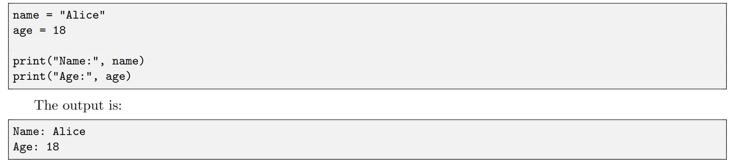
Input and Output -- print()
  The print() function displays values on the screen：
Several values can be printed together by separating them with commas
This is important because it can let us know what is calculated.

Slide 54
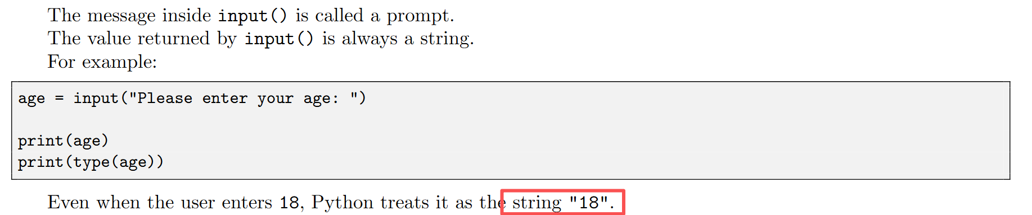
Input and Output -- input()
  The input() function allows a user to enter information：
  This 18 cannot be directly used for calculations!

Slide 55
Statements and Functions
  Example: write the area calculation from Example 2.1 as a function
  def calTri(a,b,c):
  h = (a+b+c)/2
  s = math.sqrt(h*(h-a)*(h-b)*(h-c))
  return s
    When the input is a=2, b=3, c=4, you can call calTri to get the area
  We will learn more about functions later!
  Here we only introduce a few simple built-in functions

Slide 56
Statements and Functions
  type(), id(), help(), len(), sum(), max(), min(), and others (try them in the interpreter)
  The input() and print() functions enable user interaction
Built-in Function Example 1
>>> s="Python is fun"
>>> type(s) # returns the data type of object s. Output: <class 'str'>
>>> len(s) # returns the length of string s. Output: 13
>>> s1 = [1,2,3,4,5]
>>> max(s1) # returns the maximum value in list s1. Output: 5
>>> min(s1) # returns the minimum value in list s1. Output: 1
>>> sum(s1)/len(s1) # returns the average value of list s1. Output: 3.0

Slide 57
Statements and Functions
  With an import statement, you can import a module and call functions in it using module.function(arguments)
    import module_name # import a module
      module_name.function_name() # use a function from the imported module
      module_name.variable # use a variable from the imported module
    For example, after import math:
      math.sqrt -- square root; math.sin -- sine function
    import random
      Control random number generation
  Python provides many built-in functions, standard library functions, and third-party module functions
    We can download third-party packages
    Import other .py files to call functions and classes defined in those files

Slide 58
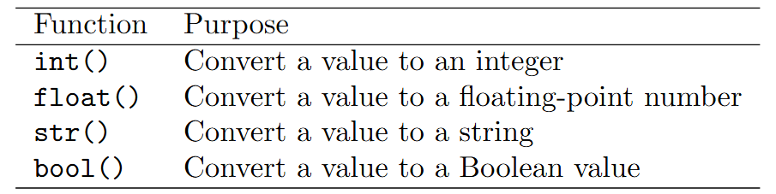
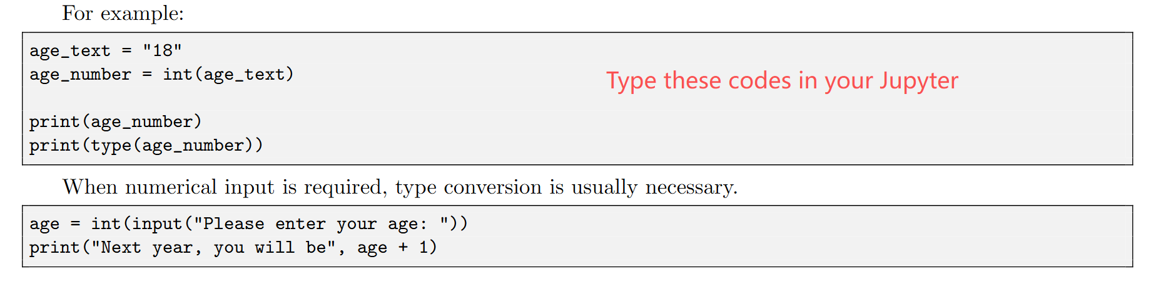
Type Conversion
  Type conversion changes a value from one data type to another.
  Convert from one data type to another

Slide 59
Expressions and Operators
  Operands, operators, and parentheses form expressions according to rules: 4 + 5 = 9 (4 and 5 are operands; + is the operator)
  Mathematical formulas cannot be written directly; they must be represented with operators
  Expressions are written from left to right on the same baseline. For example, the mathematical formula a2+b2 should be written as a**2+b**2 (a*a+b*b)
  The multiplication sign cannot be omitted. For example, the formula ab (meaning a times b) should be written as a*b
  Parentheses must appear in pairs, and only round parentheses are used; they can be nested

Slide 60
Expressions and Operators
  Python supports the following types of operators:
    Arithmetic operators: +, -, *, /
    Comparison (relational) operators: >, <, <=, >=
    Assignment operators: +=, -=, =
    Logical operators: and, or
    Bitwise operators:
    Membership operators: in, not in
    Identity operators: is, is not
    Operator precedence

Slide 61
Arithmetic Operators
  a = 10, b = 21
Operator | Description | Example
+ | Addition - add two objects | a + b outputs 31
- | Subtraction - get a negative number or subtract one number from another | a - b outputs -11
* | Multiplication - multiply two numbers or return a repeated string | a * b outputs 210
/ | Division - x divided by y | b / a outputs 2.1
% | Modulo - returns the remainder of division | b % a outputs 1
** | Exponentiation - returns x to the power of y | a**b is 10 to the 21st power
// | Floor division - rounds down to an integer | 9//2 = 4；-9//2 = -5

Slide 62
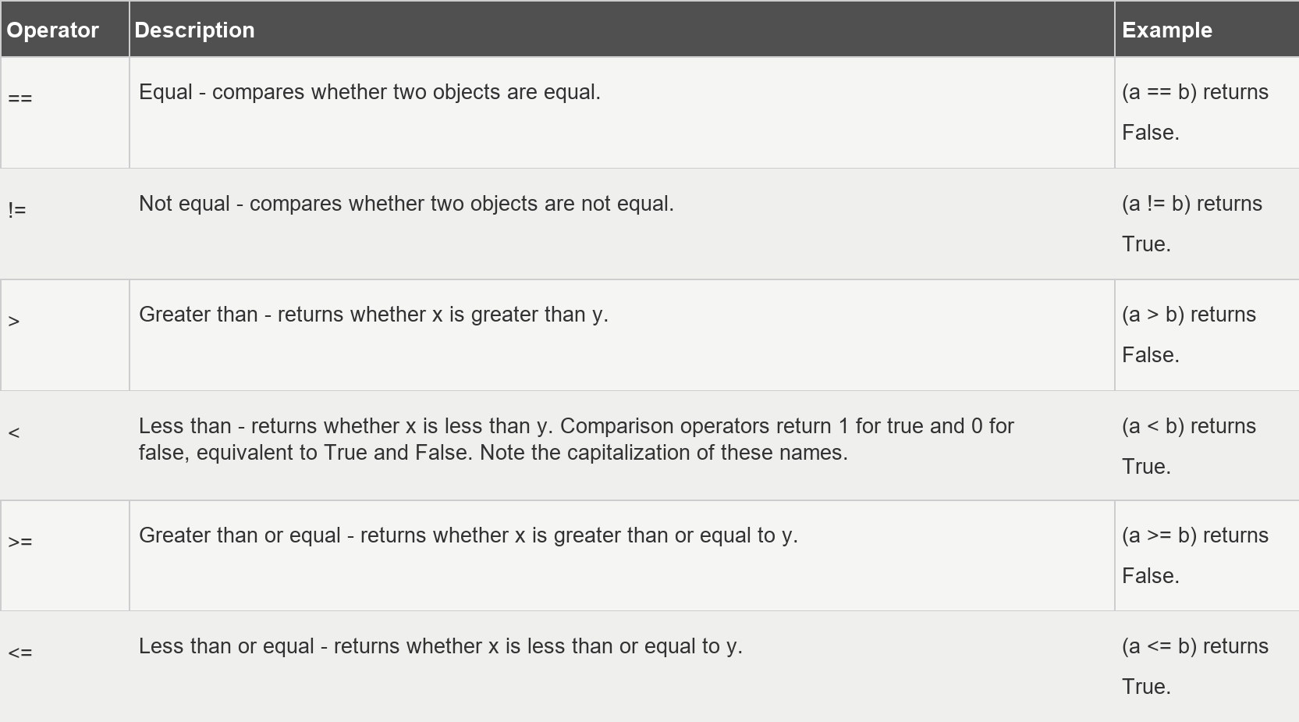
Comparison Operators
  a = 10, b = 20

Slide 63
Assignment Operators
  a = 10, b = 20
Operator | Description | Example
= | Simple assignment operator | c = a + b assigns the result of a + b to c
+= | Addition assignment operator | c += a is equivalent to c = c + a
-= | Subtraction assignment operator | c -= a is equivalent to c = c - a
*= | Multiplication assignment operator | c *= a is equivalent to c = c * a
/= | Division assignment operator | c /= a is equivalent to c = c / a
%= | Modulo assignment operator | c %= a is equivalent to c = c % a
**= | Exponentiation assignment operator | c **= a is equivalent to c = c ** a
//= | Floor-division assignment operator | c //= a is equivalent to c = c // a

Slide 64
Logical Operators
  a = 10, b = 20
Operator | Logical Expression | Description | Example
and | x and y | Boolean AND - if x is False, x and y returns x; otherwise it returns the evaluated value of y. | (a and b) returns 20.
or | x or y | Boolean OR - if x is True, it returns x; otherwise it returns the evaluated value of y. | (a or b) returns 10.
not | not x | Boolean NOT - if x is True, returns False. If x is False, returns True. | not(a and b) returns False

Slide 65
Membership Operators
Operator | Description | Example
in | Returns True if the value is found in the specified sequence; otherwise returns False. | x in sequence y; if x is in sequence y, returns True.
not in | Returns True if the value is not found in the specified sequence; otherwise returns False. | x not in sequence y; if x is not in sequence y, returns True.

Slide 66
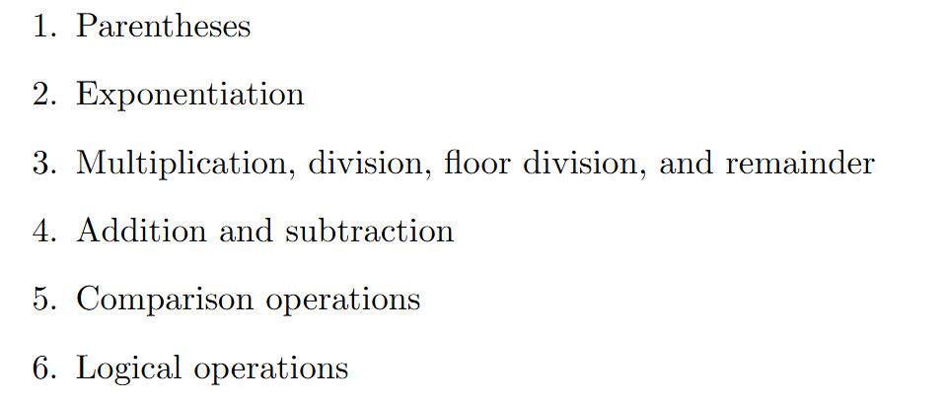
Operator Precedence (Commonly Used)
  Parenthesized expressions > indexing, slicing, calls, attribute references > exponentiation > multiplication, matrix multiplication, division, floor division, remainder > addition and subtraction > comparisons > logical NOT > logical AND > logical OR > conditional expression (if-else) > lambda expression > assignment expression
  Example: x = True; y = False; z = False
if x or y and z:
print("yes")
else:
print("no")
if (x or y) and z:
print("yes")
else:
print("no")
Notes:
# Equivalent to x or (y and z): outputs yes; # Add parentheses manually to change the order: outputs no

Slide 67
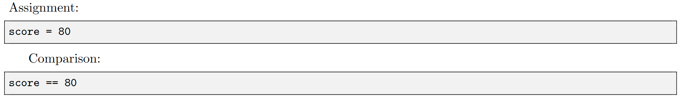
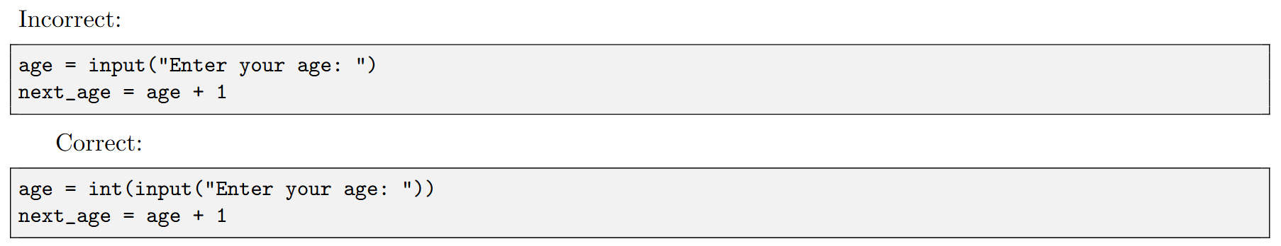
Some Common Beginner Mistakes
Forgetting Quotation Marks
Using = Instead of ==
Using Numerical Input Without Conversion

Slide 68
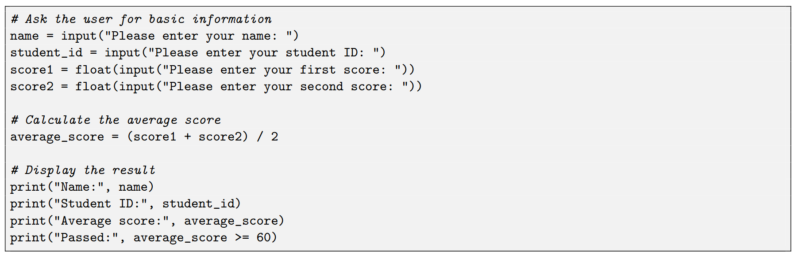
A Simple Example - 1
Notes:
# Equivalent to x or (y and z): outputs yes; # Add parentheses manually to change the order: outputs no

Slide 69
A Simple Example - 2: Temperature Conversion Code Analysis
Notes:
Explain line by line

Slide 70
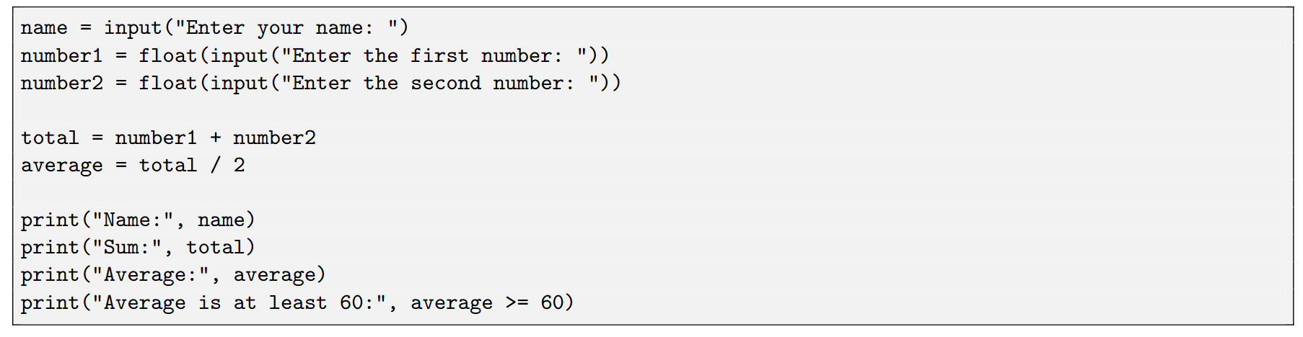
A Quick Practice
Try to write a short Python program that:
1. Asks the user to enter a name.
2. Asks the user to enter two numbers.
3. Calculates the sum and average of the two numbers.
4. Prints the name, sum, and average.
5. Checks whether the average is greater than or equal to 60.

Slide 71
It is not necessary to memorize all the syntax immediately.
The main goal is to recognize these elements and
become comfortable with reading and running simple Python programs.

